Slide 1
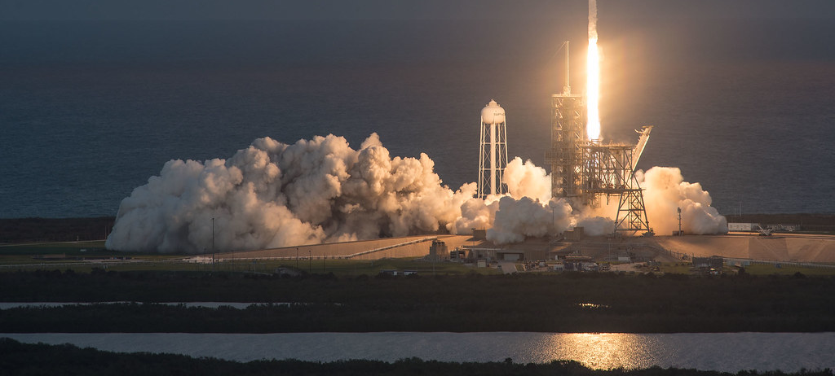
Leading Space Race with Data Science: A Capstone Project of SpaceX
Devansh Pathak
September 15, 2023

Slide 2
Outline
Executive Summary
Introduction
Methodology
Results
Discussion
Conclusions

Slide 3
Executive Summary
This undertaking aims to employ machine learning classification algorithms to forecast the successful landing of Falcon 9 first stage.
The project encompasses several key phases:
Data Gathering: The initial step involves collecting the necessary data.
Exploratory Data Analysis (EDA): Thoroughly examining the collected data to understand its characteristics and gain insights
Data Visualization: Utilizing visualization techniques to depict the aspects of rocket launches associated with their outcomes, whether they are successful or not.
Machine Learning Prediction: Employ machine learning models for predictive analysis.
Through the use of data visualization, this project illuminates the factors influencing the success or failure of rocket launches. The conclusive findings indicate that the decision tree algorithm stands out as the most effective machine learning method for forecasting the successful landing of the Falcon 9 first stage.

Slide 4
Introduction
This project is designed to forecast the successful landing of the Falcon 9 first stage. SpaceX promotes Falcon 9 rocket launches on its website at a price of 62 million dollars, while other companies charge as much as 165 million dollars for their launches. Much of SpaceX's cost advantage is attributed to their ability to reuse the first stage. Consequently, the ability to predict the first stage's landing outcome allows for a more accurate estimation of launch costs. This information can prove invaluable should another company seek to compete with SpaceX in the rocket launch industry.
It's noteworthy that a significant proportion of failed landings are deliberate, as SpaceX occasionally opts for controlled landings in water.
The central question we aim to address in this project revolves around determining whether, given a specific set of Falcon 9 rocket launch parameters such as cargo tonnage, orbit type, launch site, and more, the first stage of the rocket will successfully achieve a landing.

Slide 5
Methodology
Section 1

Slide 6
Methodology
Data Collection and Data Wrangling
SpaceX API
Web Scrapping
Exploratory Data Analysis (EDA)
Pandas and Numpy
SQL
Data Visualization
Matplotlib and Seaborn
Folium
Dash
Machine Learning Prediction
Logistic Regression
SVM
Decision Tree
K-Nearest Neighbors (KVM)

Slide 7
Data Collection
Data collection involves the systematic acquisition and measurement of information related to specific variables within an established system. This process enables us to address pertinent questions and assess the outcomes of interest. As mentioned earlier, our dataset was sourced from Wikipedia using a combination of REST API and web scraping techniques.
For the REST API approach, we initiated the process with a GET request. Subsequently, we encoded the response content in JSON format and transformed it into a pandas data frame using the json_normalize() function. Following this, we conducted data cleaning, identifying and addressing missing values to ensure data completeness.
In the case of web scraping, BeautifulSoup was employed to extract launch records presented as an HTML table. We then parsed this table and converted it into a pandas dataframe, facilitating further analysis of the data.

Slide 8
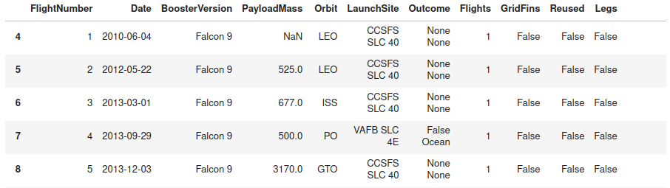
Data Collection – SpaceX API
In this phase, we initiated an API request to obtain SpaceX launch data using the provided API. To refine the dataset, we applied filters to include only Falcon 9 launches, as the API encompasses information regarding a range of rocket launches conducted by SpaceX.
To ensure data completeness, any missing values within the dataset were replaced with the mean of the respective column to which they belong.
This image provides a glimpse of the data, highlighting a selection of rows and columns from the dataset.
Below is a snapshot of the dataset, illustrating a subset of rows and columns:

Slide 9
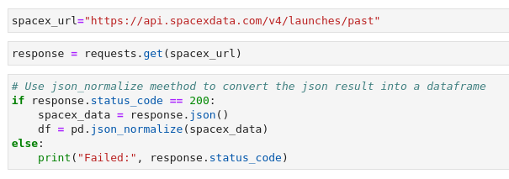
Create API GET request, normalize data and read into a DataFrame

Slide 10
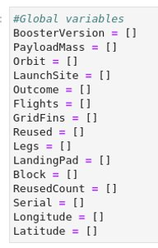
Declare global variable lists that will store data returned by helper functions with additional API calls to get relevant data

Slide 11
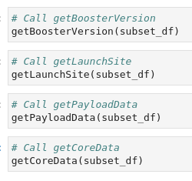
Call helper functions to get relevant data where columns have IDs

Slide 12
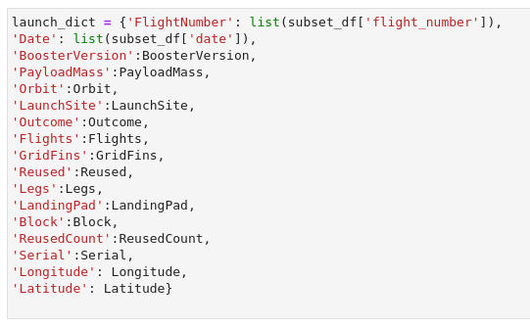
Construct dataset from received data & combine columns into a dictionary

Slide 13
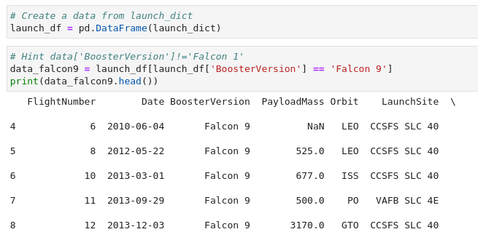
Create DataFrame from dictionary and filter to keep only the Falcon 9 launches

Slide 14
Data Collection – Web Scraping
In this phase, we conducted web scraping to gather historical launch records for Falcon 9 rockets. Our data source was a Wikipedia page titled "List of Falcon 9 and Falcon Heavy launches."
Here's a breakdown of the process:
We initiated a request to access the Wikipedia page specifically dedicated to Falcon 9 launches by using its URL.
We utilized BeautifulSoup, a powerful web scraping library, to extract the Falcon 9 launch records directly from the Wikipedia page. This involved parsing the table containing the launch information.
The extracted launch records were then converted into a pandas data frame. This transformation facilitated further analysis and manipulation of the data for our project.

Slide 15
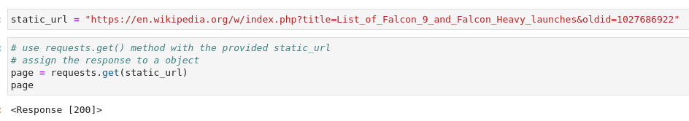
Create API GET method to request Falcon 9 launch HTML page

Slide 16

Create BeautifulSoup Object

Slide 17
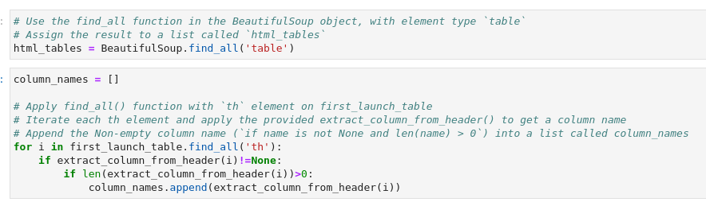
Find all the tables on the Wiki page and extract relevant column names from HTML table header

Slide 18
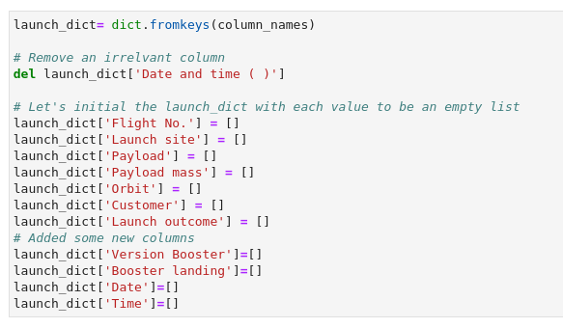
Create an empty Dictionary with keys from extracted column names

Slide 19
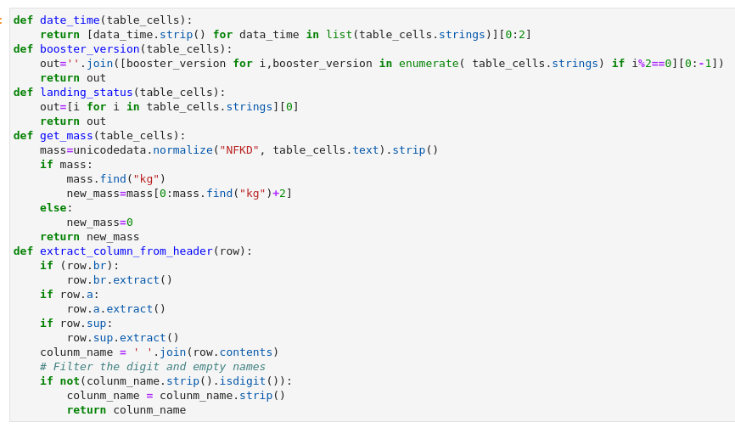
Fill up the launch_dict with launch records extracted from table rows by utilizing helper functions to help parse HTML data

Slide 20
Convert launch_dict to DataFrame

Slide 21
Data Wrangling
In the data wrangling phase, we conducted Exploratory Data Analysis (EDA) to uncover patterns within the dataset and establish labels for training supervised models. The dataset encompassed various mission outcomes, which were transformed into training labels with the following definitions:
1: Indicates that the booster successfully landed.
0: Denotes that the booster was unsuccessful in its landing attempt.

Slide 22
Data Wrangling – Label Definition
To create these labels, we considered several landing scenarios:
True Ocean: This label represents a mission outcome where the booster successfully landed in a specific region of the ocean.
False Ocean: Signifies a mission outcome where the booster was unsuccessful in landing within a designated ocean region.
RTLS (Return to Launch Site): This label corresponds to a mission outcome where the booster successfully landed on a ground pad.
False RTLS: Indicates a mission outcome where the booster was unsuccessful in landing on a ground pad.
True ASDS (Autonomous Spaceport Drone Ship): This label is assigned to a mission outcome where the booster successfully landed on a drone ship.
False ASDS: Represents a mission outcome where the booster was unsuccessful in landing on a drone ship.
By defining these labels, we established a clear framework for training supervised machine learning models to predict the success or failure of Falcon 9 booster landings.

Slide 23
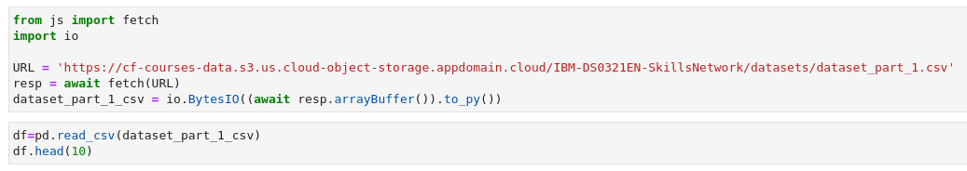
Load dataset into a DataFrame

Slide 24
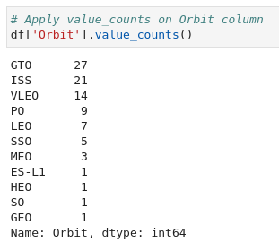
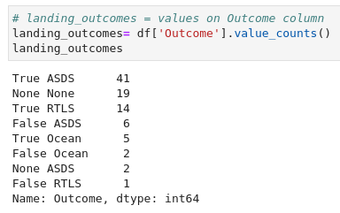
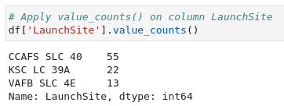
Finding Patterns

Slide 25
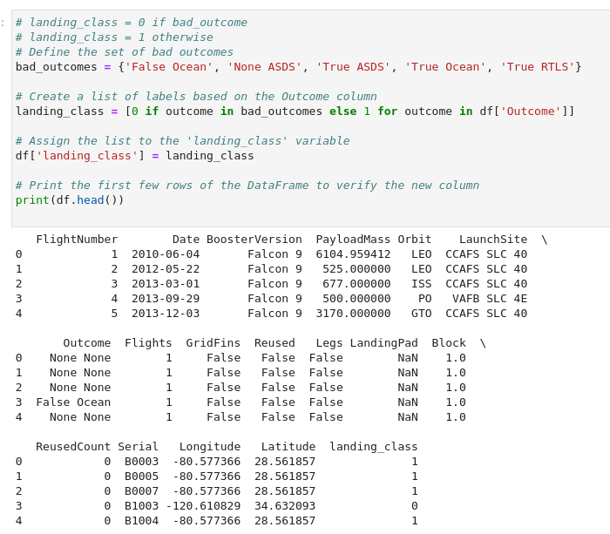
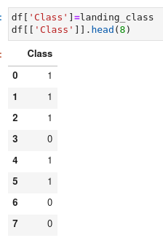
Create landing outcome label

Slide 26
EDA with Data Visualization
During the Exploratory Data Analysis (EDA) phase, we employed various charts to gain deeper insights into the dataset:
Scatter Plots: Scatter plots are effective for visualizing the relationship or correlation between two variables, making patterns easily observable. We generated the following scatter plots:
Relationship between Flight Number and Launch Site
Relationship between Payload and Launch Site
Relationship between Flight Number and Orbit Type
Relationship between Payload and Orbit Type
Bar Chart: Bar charts are a common choice for comparing the values of a variable at a specific point in time. They provide a clear visual representation of which groups are the most common and how other groups compare. Each bar's length is proportional to the value it represents. We used a bar chart to visualize the relationship between the success rate of each orbit type.
Line Chart: Line charts are useful for tracking changes over a period of time, allowing us to observe trends over time. We created a line chart to analyze the yearly trend in the average launch success rate.
These visualizations helped us uncover patterns, relationships, and trends within the dataset, facilitating a deeper understanding of the factors influencing Falcon 9 launch outcomes.

Slide 27
EDA with SQL
In the Exploratory Data Analysis (EDA) using SQL on an IBM DB2 cloud instance, the following queries and operations were conducted to gain insights into the SpaceX dataset:
Unique Launch Sites: Displayed the names of the unique launch sites in the space mission.
Launch Sites Starting with 'CCA': Displayed 5 records where launch sites begin with the string 'CCA'.
Total Payload Mass by NASA (CRS): Calculated and displayed the total payload mass carried by boosters launched by NASA under the Commercial Resupply Services (CRS) program.
Average Payload Mass for F9 v1.1: Displayed the average payload mass carried by booster version F9 v1.1.
First Successful Ground Pad Landing: Listed the date when the first successful landing outcome on a ground pad was achieved.
Boosters with Drone Ship Success and Payload Mass: Listed the names of the boosters that achieved success on a drone ship and had a payload mass greater than 4000 but less than 6000.
Total Successful and Failed Mission Outcomes: Displayed the total number of successful and failure mission outcomes.
Booster Versions with Maximum Payload Mass (Subquery): Listed the names of the booster versions that carried the maximum payload mass using a subquery.
Failed Drone Ship Landings in 2015: Listed the failed landing outcomes in a drone ship, along with their booster versions and launch site names for the year 2015.
Ranking Landing Outcomes: Ranked the count of landing outcomes (such as Failure on a drone ship or Success on a ground pad) between the dates 2010-06-04 and 2017-03-20 in descending order.
These SQL queries and operations provided valuable insights and summaries of the SpaceX dataset, enabling a comprehensive exploration of the data.

Slide 28
Creating an Interactive Map with Folium
Utilizing Folium's interactive mapping capabilities allowed for the exploration of geospatial data, enabling a more interactive visual analysis and a deeper understanding of factors such as location and proximity that influence launch success rates.
Key steps involved in building the interactive map with Folium included:
Marking Launch Sites: All launch sites were marked on the map, providing a visual representation of their locations.
Highlighting Areas: Folium's 'folium.circle' and 'folium.marker' functionalities were employed to highlight circular areas around each launch site, with text labels indicating their significance.
Clustered Markers: A 'MarkerCluster()' was added to group launch success (green) and failure (red) markers for each launch site, aiding in visualizing success rates.
Distance Calculation: Distances between launch sites and their proximity to various features like coastlines, railroads, highways, and cities were calculated.
Mouse Position: A 'MousePosition()' feature was added to provide coordinate information when hovering the mouse over a point on the map.
Distance Display: 'folium.Marker()' was used to display distances in kilometers on the map for reference points such as coastlines, railroads, highways, and cities.
Drawing Lines: 'folium.Polyline()' was employed to draw lines connecting launch sites to proximity features (e.g., coastline, railroad, highway, city).
By executing these steps, the interactive map built with Folium provided answers to important questions:
Are launch sites in close proximity to railways? (YES)
Are launch sites in close proximity to highways? (YES)
Are launch sites in close proximity to coastlines? (YES)
Do launch sites maintain a certain distance from cities? (YES)
This interactive map served as a valuable tool for analyzing and visualizing geospatial data, aiding in the assessment of factors influencing launch success rates.

Slide 29
Development of a Plotly Dash Web Application for SpaceX Launch Data
A Plotly Dash web application was created to facilitate interactive visual analytics of SpaceX launch data in real-time. Several components were added to the dashboard to enhance its functionality:
Launch Site Drop-down: An input component was incorporated into the dashboard, allowing users to filter visualizations by all launch sites or a specific launch site of interest.
Pie Chart: A pie chart was integrated into the dashboard. When 'All Sites' is selected, it displays the total count of successful launches; when a particular site is chosen, it displays both success and failure counts for that site.
Payload Range Slider: A slider for payload range selection was added, enabling users to easily choose different payload ranges and identify visual patterns.
Scatter Chart: A scatter chart was included to explore potential correlations between payload and mission outcomes for selected site(s). Additionally, each scatter point is color-labeled with the booster version, providing insights into mission outcomes with different boosters.

Slide 30
Development of a Plotly Dash Web Application for SpaceX Launch Data
The dashboard facilitated the exploration of SpaceX launch data and addressed key questions:
Largest Successful Launch Site: KSCLC-39A had the largest number of successful launches with a count of 10.
Highest Launch Success Rate: KSC LC-39A boasted the highest launch success rate at 76.9%.
Payload Range with Highest Success Rate: The payload range between 2000 kg and 5000 kg exhibited the highest launch success rate.
Payload Range with Lowest Success Rate: Payload ranges of 0-2000 kg and 5500-7000 kg had the lowest launch success rates.
F9 Booster Version with Highest Success Rate: The booster version FT had the highest launch success rate.
This Plotly Dash web application proved to be a valuable tool for real-time exploration and visualization of SpaceX launch data, providing insights into various aspects of launch success and payload outcomes.

Slide 31
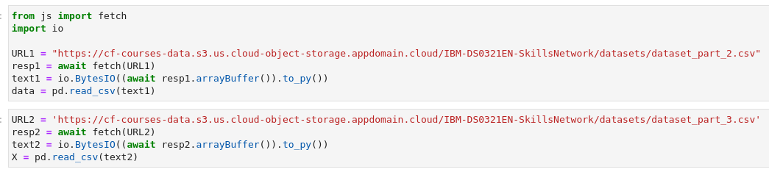

Predictive Analysis - Read dataset into DataFrame

Slide 32
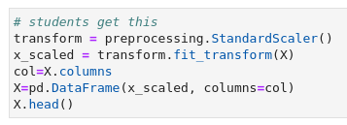
Predictive Analysis – Standardize the data

Slide 33
Predictive Analysis – Train/Test/Split data

Slide 34
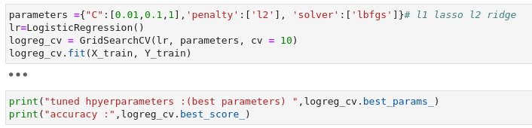
Predictive Analysis – Create & Refine Models

Slide 35
Insights drawn from EDA
Section 2

Slide 36
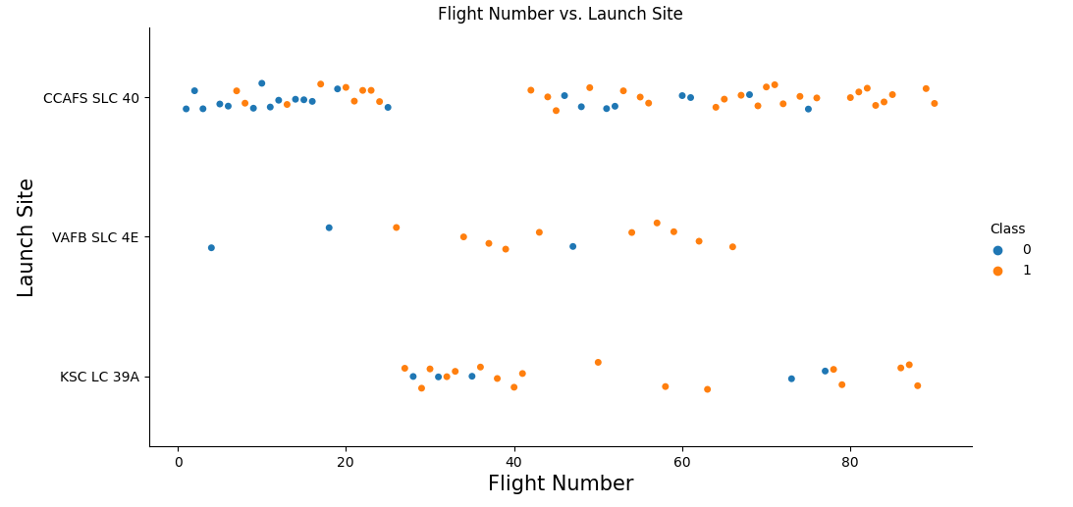
Flight Number vs. Launch Site
Success rates (Class = 1) increases as the number of flights increase
For launch site KSC LC 39A, it takes at least around 25 launches before a first successful launch

Slide 37
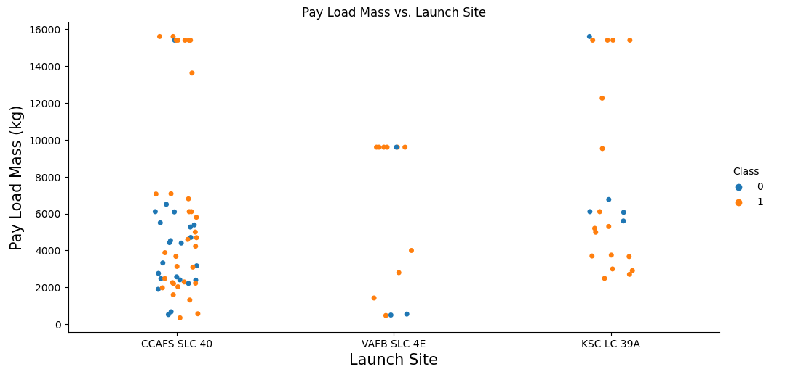
Payload vs. Launch Site
For lauch site VAFB SLC 4E, there are no rockets launched for payload greater than 10,000 kg
Percentage of successful launch (Class = 1) increases for launch site VAFB SLC 4E as the payload mass increases
There is no clear correlation or pattern between launch site and payload

Slide 38
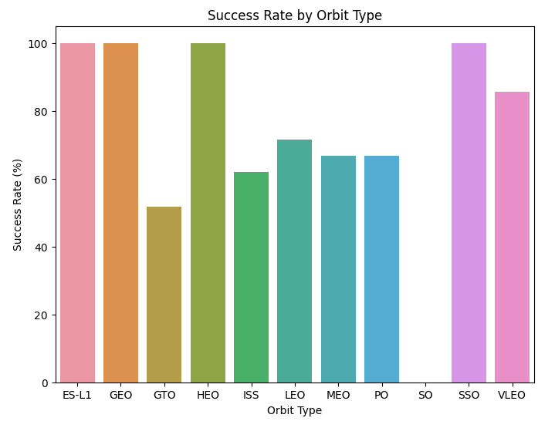
Success Rate vs. Orbit Type
Orbits ES-L1, GEO, HEO, and SSO have the highest success rates
GTO orbit has the lowest success rates

Slide 39
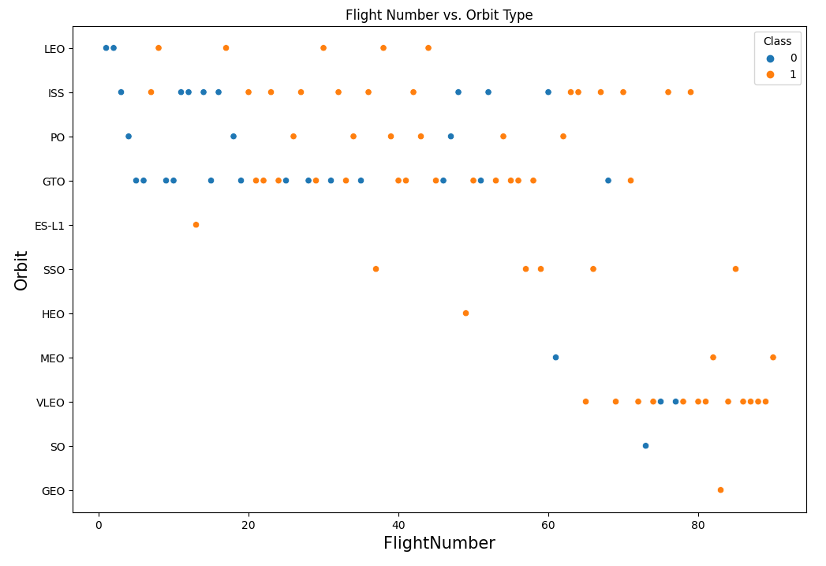
Flight Number vs. Orbit Type
For orbit VLEO, first successful landing (Class = 1) does not occur until 60+ number of flights
For most orbits (LEO, ISS, PO, SSO, MEO, VLEO) successful landing rates appear to increase with flight numbers
There is no relationship between flight number and orbit for GTO

Slide 40
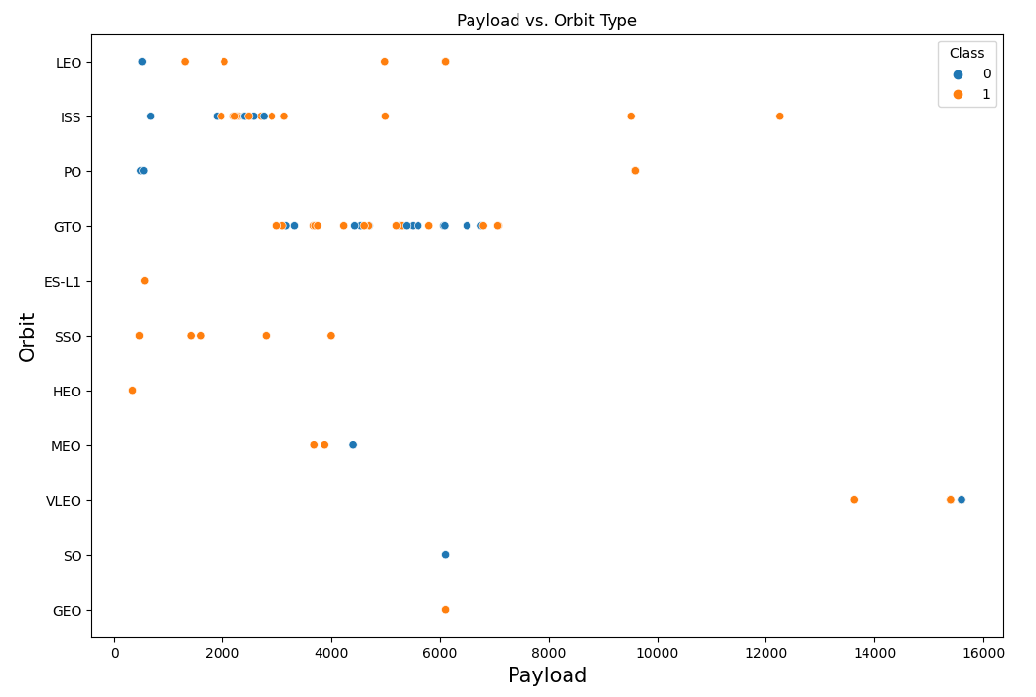
Payload vs. Orbit Type
Successful landing rates (Class = 1) appear to increase with payload for orbits LEO, ISS, PO, and SSO
For GEO orbit, there is no clear pattern between payload and orbit for successful or unsuccessful landing

Slide 41
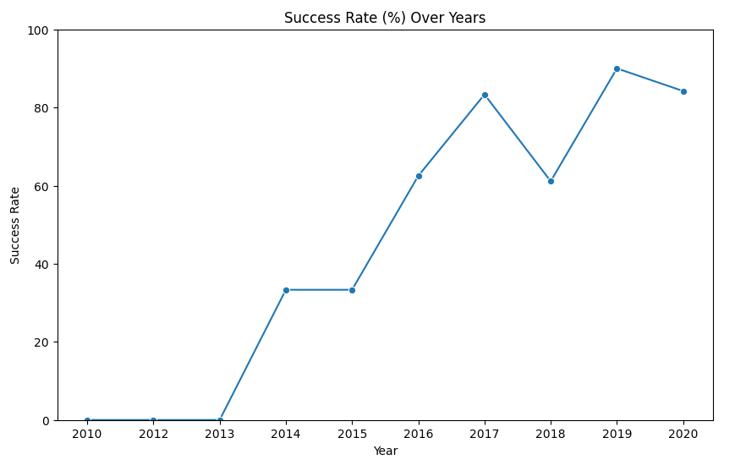
Success Rate Over Years
Success rate (Class = 1) increased by about 80% between 2013 to 2020
Success rates remained the same between 2010 and 2013; and between 2014 and 2015
Success rates decreased between 2017 and 2018; and between 2019 and 2020

Slide 42
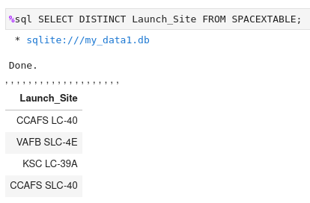
All Launch Site Names
'SELECT DISTINCT' returns only unique values from the queries column (launch_site)
There are 4 unique launch sites

Slide 43
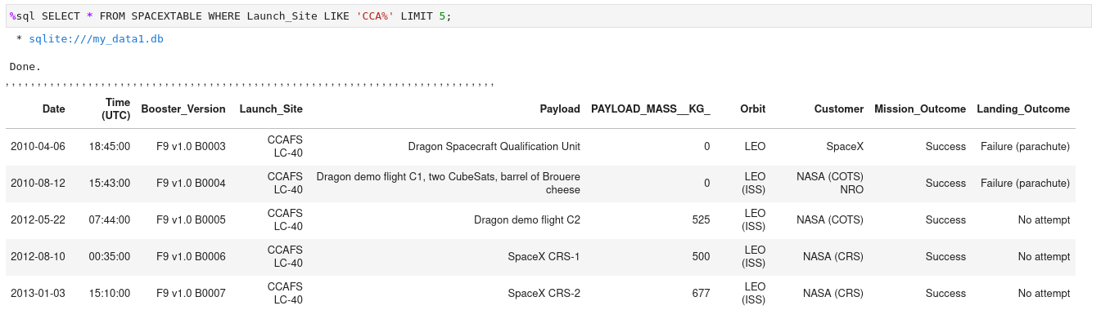
Launch Site Names Begin with CCA
Using keywords 'LIKE' and format 'CCA%' returns records where 'launch_site' column starts with 'CCA'
'LIMIT 5' limits the number of returned records to 5

Slide 44
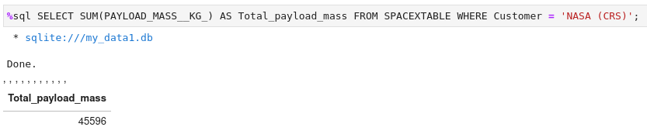
Total Payload Mass
'SUM' adds column 'PAYLOAD_MASS_KG' and returns total payload mass for customers names 'NASA (CRS)'

Slide 45
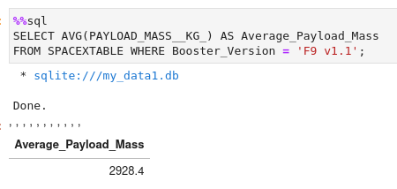
Average Payload Mass by F9 v1.1
'AVG' keyword returns the average of payload mass in 'PAYLOAD_MASS_KG' column where booster version is 'F9 v1.1'

Slide 46
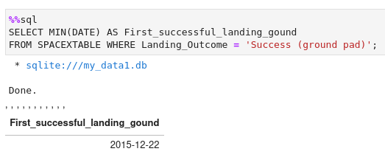
First Successful Ground Landing Date
'MIN(DATE)' selects the first or the oldest date from the 'Date' column where first successful landing on group pad was achieved
'WHERE' defines the criteria to return date for scenarios where 'Landing_Outcome' value is equal to 'Success (ground pad)'

Slide 47
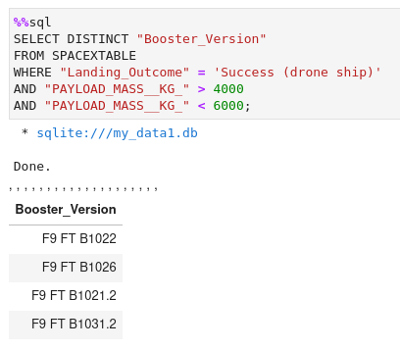
Successful Done Ship Landing with Payload between 4000 and 6000
The query finds the booster version where payload mass is greater than 4000 but less than 6000; 'Landing_Outcome' is success in drone ship
The 'AND' operator in the 'WHERE' clause returns booster versions where both conditions is true

Slide 48
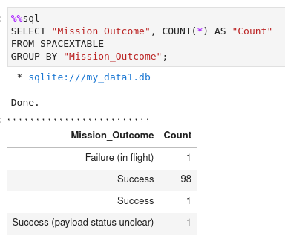
Total Number of Successful and Failure Mission Outcomes
The 'GROUP BY' arranges identical data in a column into groups
In this case, number of mission outcomes by types of outcomes are grouped in column 'counts'

Slide 49
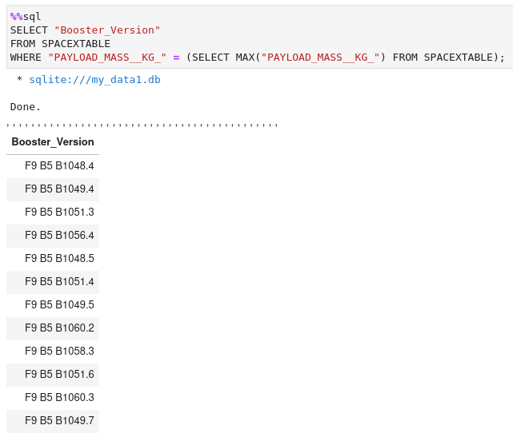
Boosters Carried Maximum Payload
The sub-query returns the maximum payload mass by using keywords 'MAX' on the payload mass column
The main query returns booster versions and respective payload mass where payload mass is maximum value of 15600

Slide 50
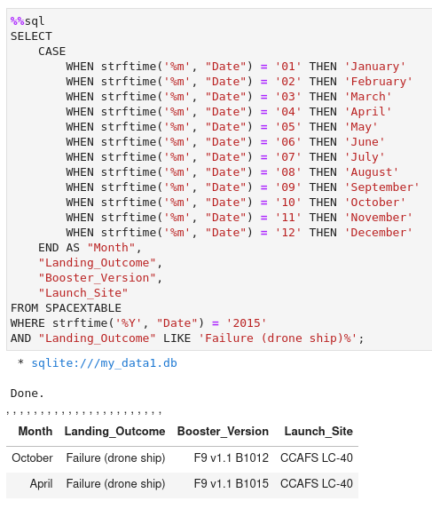
2015 Launch Records
The query lists landing outcomes, booster version, and the launch site where landing outcome is failed in drone ship in the year 2015
The 'AND' operator in the 'WHERE' clause returns booster versions where both conditions are met
The '%Y' keyword extracts the year from the column 'Date'

Slide 51
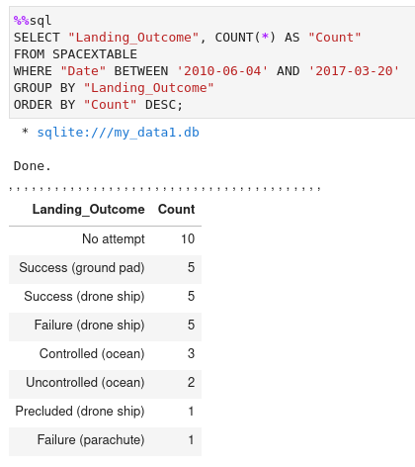
Rank Landing Outcomes Between 2010-06-04 and 2017-03-20
The 'GROUP BY' keyword arranges data in column landing outcome into groups
The 'BETWEEN' and 'AND' keywords returns the date between 2010-06-04 and 2017-03-20
The 'ORDER BY' keyword arranges the counts column in descending order
The result of the query is ranked list of landing outcome counts per the specified date range

Slide 52
Launch Site Proximities Analysis
Section 3

Slide 53
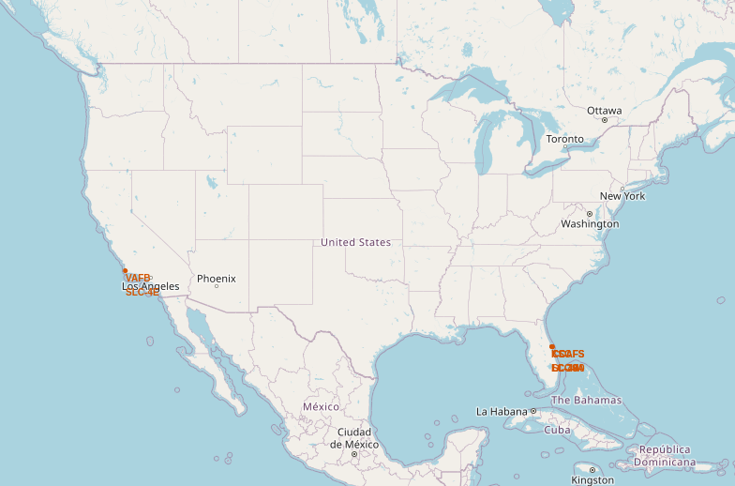
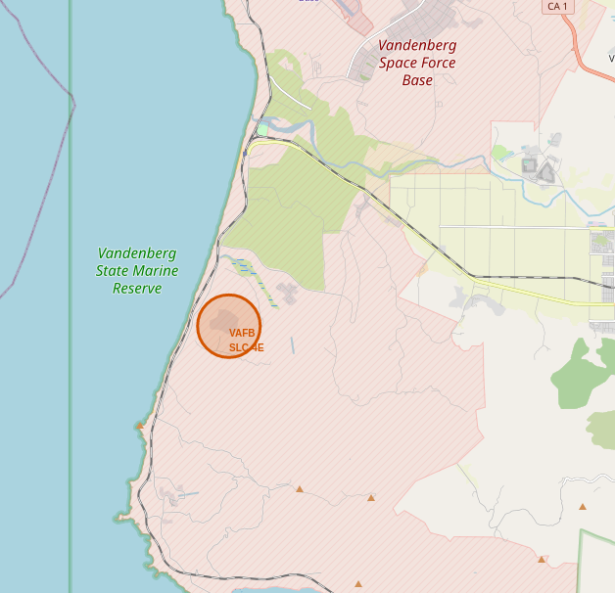
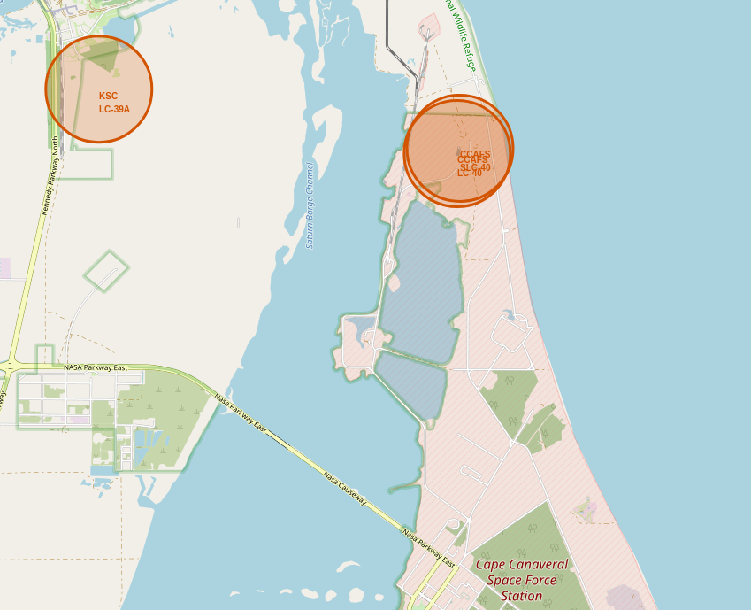
SpaceX Falcon 9 – Launch Sites Map
Figure 1.1 - Global Map with Falcon 9 launch sites located in United States (California & Florida)
Figure 1.2 & 1.3 - Zoomed launch sites to display 4 launch sites:
VAFB SLC-4E (CA)
CCAFS LC-40 (FL)
KSC LC-39A (FL)
CCAFS SLC-40 (FL)
Figure 1.1 - Global Map
Figure 1.2 - Zoom 1
Figure 1.3 - Zoom 2

Slide 54
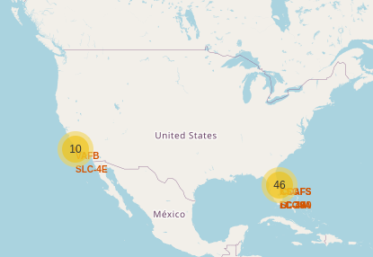
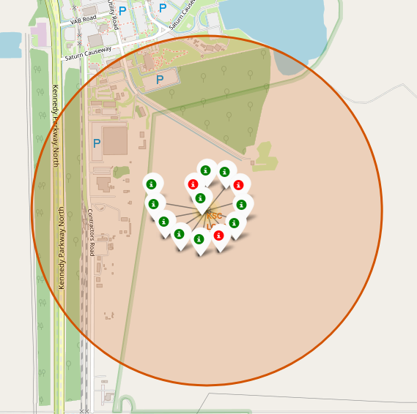
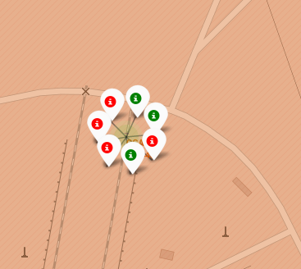
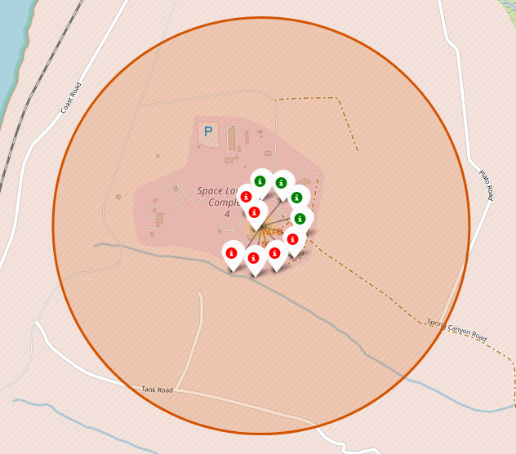
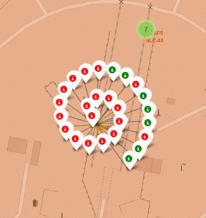
SpaceX Falcon 9 Success/Failed Map

Slide 55
Build a Dashboard with Plotly Dash
Section 4

Slide 56
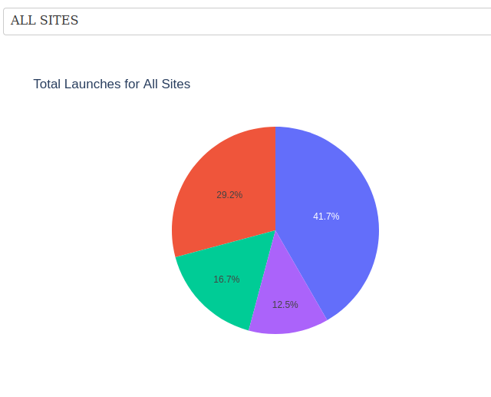
Launch Success Counts For All Sites
Launch Site KSC LC-39A has the highest launch success rate
Launch Site CCAFL SLC-40 has the lowest launch success rate

Slide 57
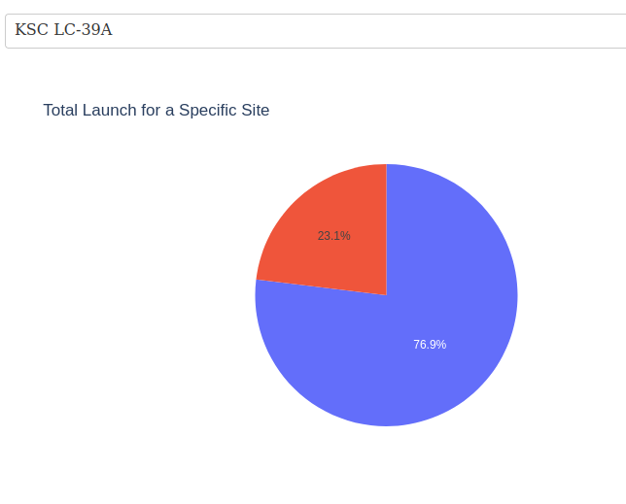
Launch Site with Highest Success Ratio
KSC LC-39A launch site has the highest launch success rate
Launch success rate is 76.9%
Launch success failure is 23.1%

Slide 58
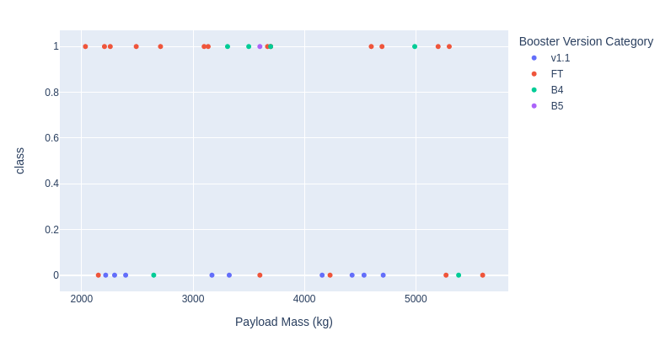
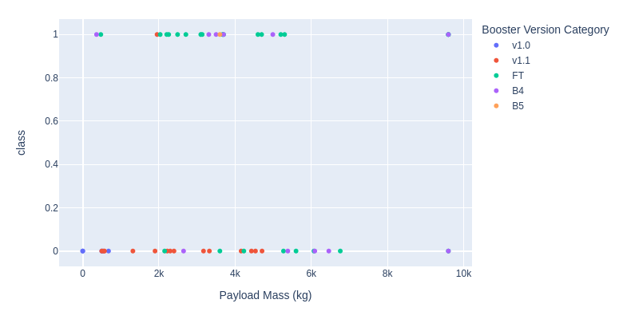
Payload vs. Launch Outcomes
Most successful launches are in the payload range from 2000 to 5500
Booster version category 'FT' has the most successful launches
Only booster with a success launch when payload is greater than 6000 is B4

Slide 59
Predictive Analysis
Section 5

Slide 60
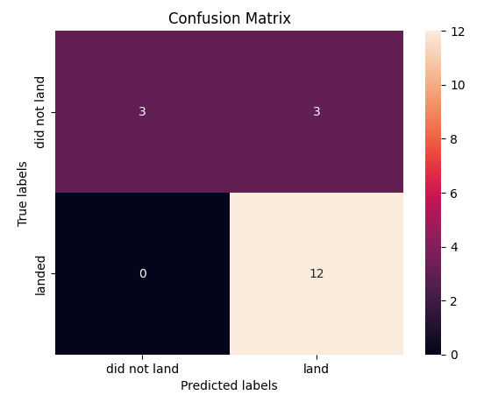
Confusion Matrix
The confusion matrix is the same for all models (LR, SVM, Decision Tree, KNN).
According to the confusion matrix, there were 18 predictions made.
12 scenarios were predicted as "Yes" for landing, and they successfully landed (True positive).
3 scenarios (top left) were predicted as "No" for landing, and they did not land (True negative).
3 scenarios (top right) were predicted as "Yes" for landing, but they did not land successfully (False positive).
Overall, the classifier is correct about 83% of the time ((TP + TN) / Total) with a misclassification or error rate ((FP + FN) / Total) of about 16.5%.

Slide 61
Discussion
With an increase in the number of flights, the likelihood of a successful landing in the first stage also rises.
While success rates tend to rise alongside increased payload, there is no evident correlation between payload mass and success rates.
From 2013 to 2020, there was an approximately 80% increase in the launch success rate.
Among launch sites, 'KSC LC-39A' boasts the highest launch success rate, while 'CCAFS SLC-40' exhibits the lowest.
The orbits ES-L1, GEO, HEO, and SSO demonstrate the highest launch success rates, whereas GTO exhibits the lowest.
Launch sites have been strategically positioned away from urban areas, closer to coastlines, railways, and highways.
The Decision Tree model outperforms all others in machine learning classification, achieving an accuracy of approximately 87.5%. When evaluated on test data, all models achieve an accuracy score of around 83%. Further data may be necessary for fine-tuning the models and potentially finding a better fit.

Slide 62
Conclusion
Project objective: Create a machine learning model for SpaceX landing.
Data sources: Utilized data from a public SpaceX API and conducted web scraping of the SpaceX Wikipedia page.
Data processing: Generated data labels and stored the collected data in a DB2SQL database.
Visualization: Developed a dashboard for data visualization.
Utilization: SpaceX can employ this model to make informed launch decisions by predicting Stage 1 landing success prior to liftoff.
Data enhancement: To improve the model's accuracy and select the optimal machine learning approach, it is advisable to gather additional data.

Slide 63
Thank you!

